Slide 1

Borrower funnel dropoff study
Numbers, analysis, & recommendations
[Edited excerpt to respect confidentiality]
John Boykin, UX
View in slideshow mode

Slide 2
Steps in the funnel
Register
Offers
Personal details
TIL
Thank you

Slide 3
Project Overview
Project Overview
OBJECTIVE
Understand dropoff and other behavior along each step of borrower funnel
Figure out ways to plug holes in that bucket
METHOD
Omniture data for Jan 1 to Feb 20
[x] arrivals on Register page
CAVEATS
Some dropoff inevitable (not serious, rate too high, we reject)
Treat numbers as indicative, not definitive
  Short history of data collection: work in progress
  Omniture & data warehouse measure different things, so numbers don’t match
  Totals for pages, not unique visitors
  Time factor (return later vs. gone forever)

Slide 4
Prior prospect research in a nutshell
They have lots of questions. Lots.
Who the %@$#^ is Prosper?
Are you legit?
Why should I trust you?
How does Prosper work?
How is this different from a bank loan?
What do trusted third parties think of Prosper?
Are you a shell just generating leads for someone else?
What are you going to do with my info?
Am I going to get spammed?
Will you sell my info to someone else?
Is my info safe from hackers?
What info are you going to need from me?
Is this going to mean a hard hit on my credit score?
Do you offer better rates than other places?
How long is this going to take?
When will I get the money?
How will I get the money?
What if I don't want to let you into my bank account?
How can I avoid putting my SSN online?
Who the #$%@ is WebBank?
Is Prosper just a salesman for WebBank?
Who's going to help me if I have a problem?
How did you arrive at the numbers you're showing me?
Can I set my own payment schedule?
What if I need to be a little late sometimes?
What if I want to pay my loan off early?

Slide 5
UPSHOT
We must answer their questions before they will answer ours
(i.e., fill out application form)

Slide 6
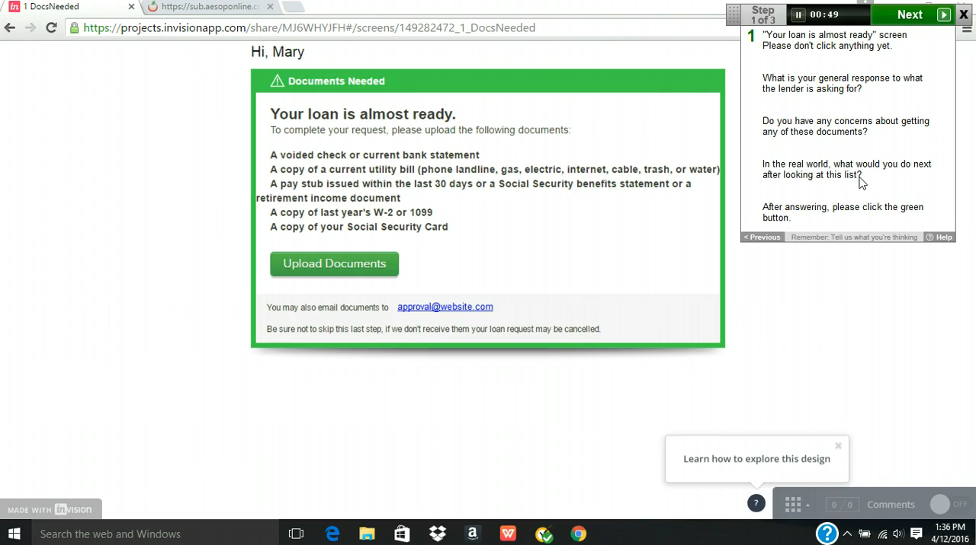

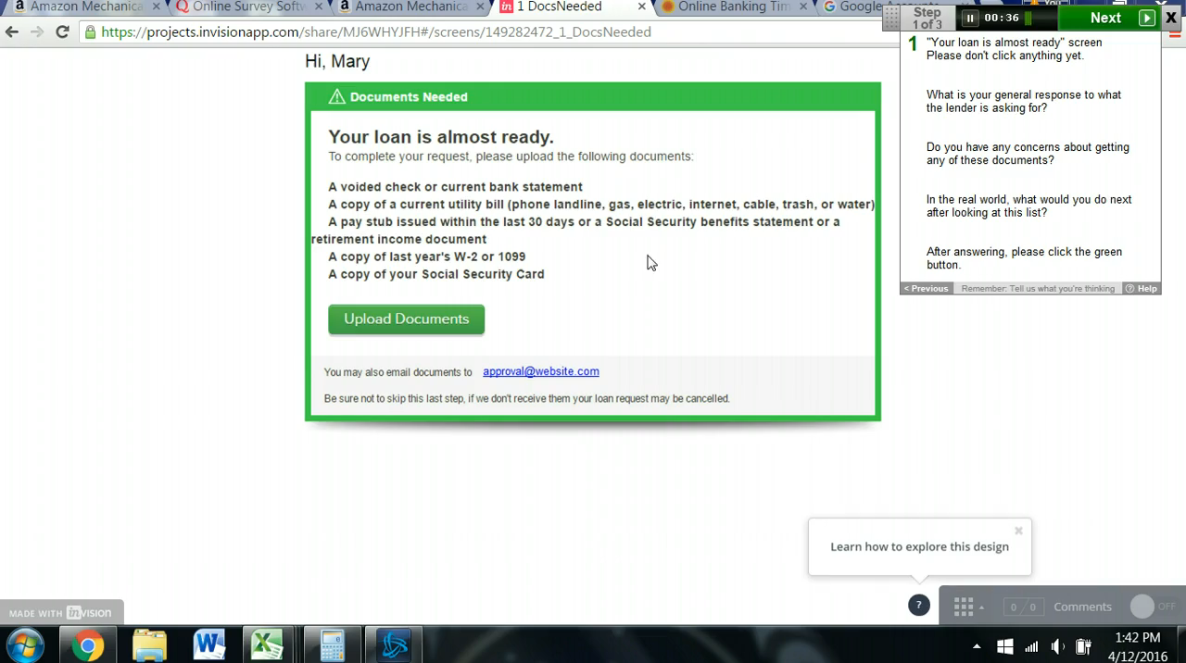

Prior research findings
Trust is a very big issue
  Only just heard of us
  Loans field infected with scammers & sharks
  Loan app is gold mine for ID thieves
  Need constant assurance they are in good hands
  No surprises, inconsistencies, whiffs of deception
Prospective borrowers take this seriously & expect us to
  Applying for loan is major commitment, don’t enter lightly
  Take their time, resent feeling hurried or sold to
  Inappropriate ease/simplicity/speed raises suspicions
  Demand more info, not less
  Read carefully & double-check our math

Slide 7
Basic picture
that emerged

Slide 8

Basic picture of shoppers
Basic picture that emerged from this funnel study
We’re trying to marry on first date
Most are just shopping for rates now
[x]% won’t give personal info to see rate
Less than [x]% of those who start proceed beyond rate
Funnel is sequence of unpleasant surprises
Resistance to giving bank info

Slide 9
Step by step through funnel
[only 1 shown here, for illustration]

Slide 10
Dropoff viewed as straight percentages: Offers page
Offers
[specific numbers confidential]
Proceed
39%
Depart
61%

Slide 11
Dropoff viewed as straight percentages
Register
[specific numbers confidential]
Offers
[specific numbers confidential]
Personal
details
Error
8%
[specific numbers confidential]
Reject
22%
Proceed
34%
Proceed
39%
Proceed
63%
Error 5%
Depart
61%
Depart
29%
Depart
39%
TIL
[specific numbers confidential]
Bank
[specific numbers confidential]
Depart
31%
Proceed
68%
Depart
45%
Proceed
54%
Thank you

Slide 12
Observations & comments

Slide 13
Observations & comments
  Compare the 2 critical numbers
  Extra completed apps attributable to emails
  - Dropoff attributable to requiring email & password
  = Payoff
SEEING RATE
It is in our own interest for everyone to see their rate
  No one will ever apply without seeing rate
  Hurdles to seeing rate just increase dropoff
  [x] in [y] are unwilling to give personal info in order to see rate
  Requiring email address before showing rate probably does more harm than good, given [x] % dropoff on Reg
MISC.
Behavior is consistent with encountering a series of unpleasant surprises
Unclear when one is actually placing app (Offers: “Get this loan” but TIL: “Continue”)
Timing out tends to drive people away
A lot are uncomfortable/unwilling to give bank info
The farther one goes, the more likely to keep going

Slide 14
Top recommendations
Register
Offers
Personal details
TIL
Thank you

Slide 15

Recommendations: Overall
  Assume they’re just shopping rates now, will return to apply
  Eliminate hurdles to seeing rate
  Offer but do not REQUIRE login for returning users to resume
  Let them start over from scratch if they choose/must
Prominent & persistent on each screen:
Articulate what to expect, we’re legit, info secure & confidential
Err on the side of more info, not less
No surprises
Show the arithmetic
  Fundamentally rethink timeout (e.g., time limit, warning, reset clock, hide entries but continue)
A/B test changes

Slide 16
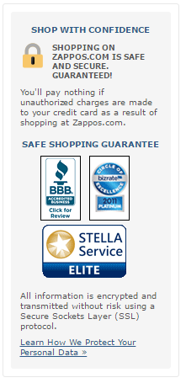
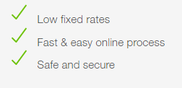
Recommendations: Overall
  Assume they’re just shopping rates now, will return to apply
  Eliminate hurdles to seeing rate
  Offer but do not REQUIRE login for returning users to resume
  Let them start over from scratch if they choose/must
Prominent & persistent on each screen:
Articulate what to expect, we’re legit, info secure & confidential
Err on the side of more info, not less
No surprises
Show the arithmetic
  Fundamentally rethink timeout (e.g., time limit, warning, reset clock, hide entries but continue)
A/B test changes
Zappos
Prosper
We give less security assurance to people committing to long-term financial relationship than Zappos gives to people buying shoes

Slide 17
Recommendations: Check your rate
Offer option of an anonymous rough estimate
Get rough estimate
Get custom exact rate
Form like current Register page

Slide 18
Recommendations: Check your rate
Offer option of an anonymous rough estimate
Get rough estimate
Get custom exact rate

~4 anonymous fields
ID similar recent borrowers (no Experian)









Form like current Register page
People we gave custom
rates to in past week

Slide 19
Recommendations: Check your rate
Offer option of an anonymous rough estimate
Get rough estimate
Get custom exact rate

~4 anonymous fields
ID similar recent borrowers (no credit bureau check)
“In the past week, borrowers similar to you got rates of 7.8 to 9.3%”
CTA: “Get custom exact rate”









Form like current Register page
People we gave custom
rates to in past week

Slide 20
Recommendations: TIL ([xx]% dropoff)
Overhaul to eliminate surprises, inconsistencies, & insider terminology

Slide 21

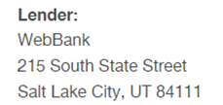
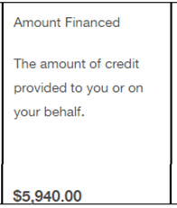
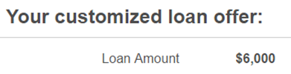

Recommendations: TIL ([xx]% dropoff)
What we told you prior to TIL
What we surprise you with at TIL

Slide 22
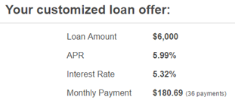
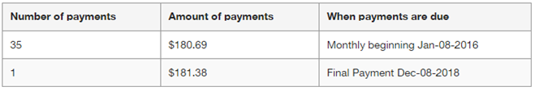
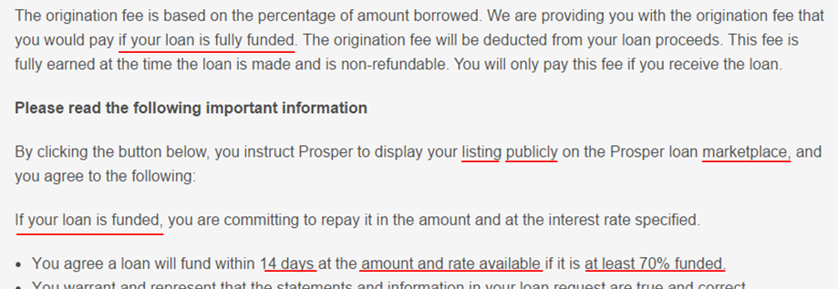
Recommendations: TIL ([xx]% dropoff)
What we told you prior to TIL
What we surprise you with at TIL
Insider content assumes borrower understands details of how Prosper works

Slide 23
Top takeaways
Dropoff is heavy at every step in funnel
Lots we can do to reduce preventable dropoff
Adapt our approach to where they are in their own process
Assume they’re just shopping rates now
Make it easy to come back & resume or start over
Offer option of anonymous rough estimate rate
Err on side of more info, not less
Spotlight what to expect, security, confidentiality
No surprises

Slide 24
Appendix:
Detailed recommendations
[omitted: confidential]

